Slide 1
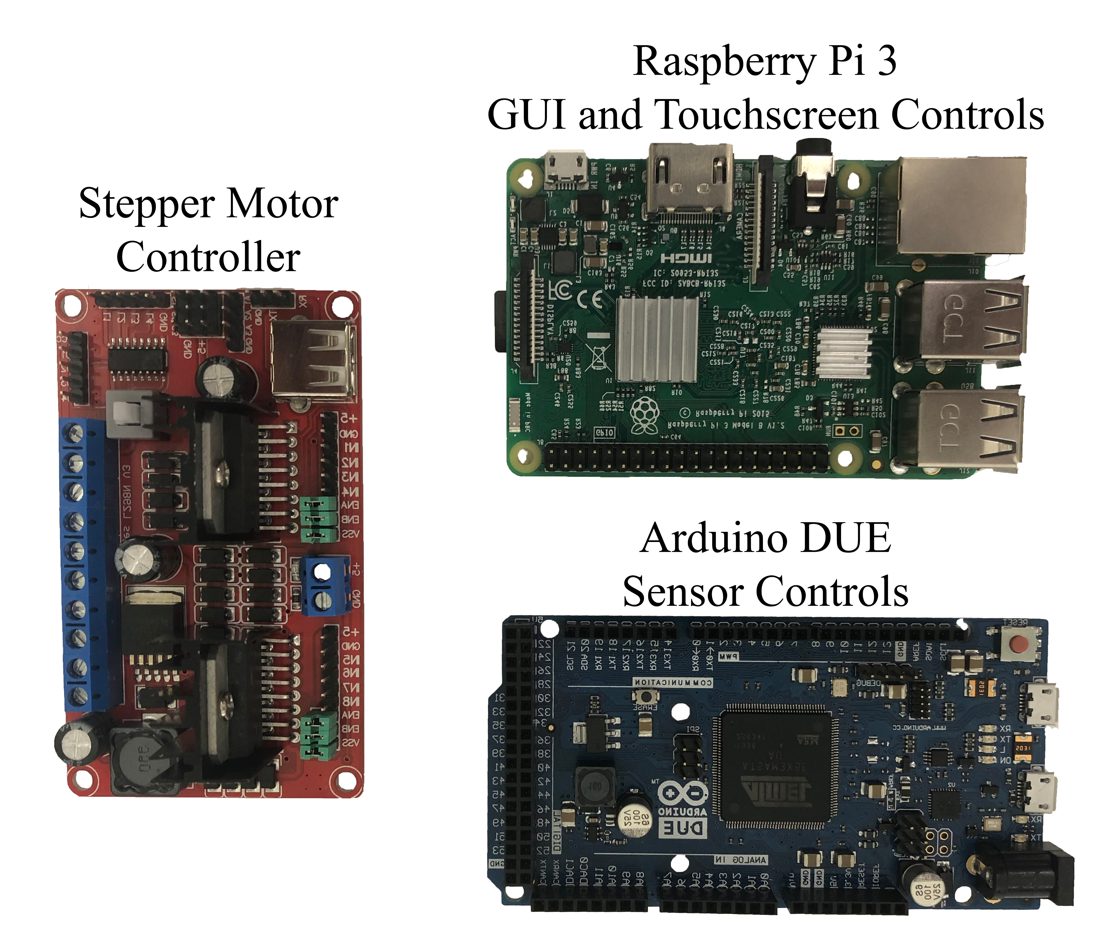
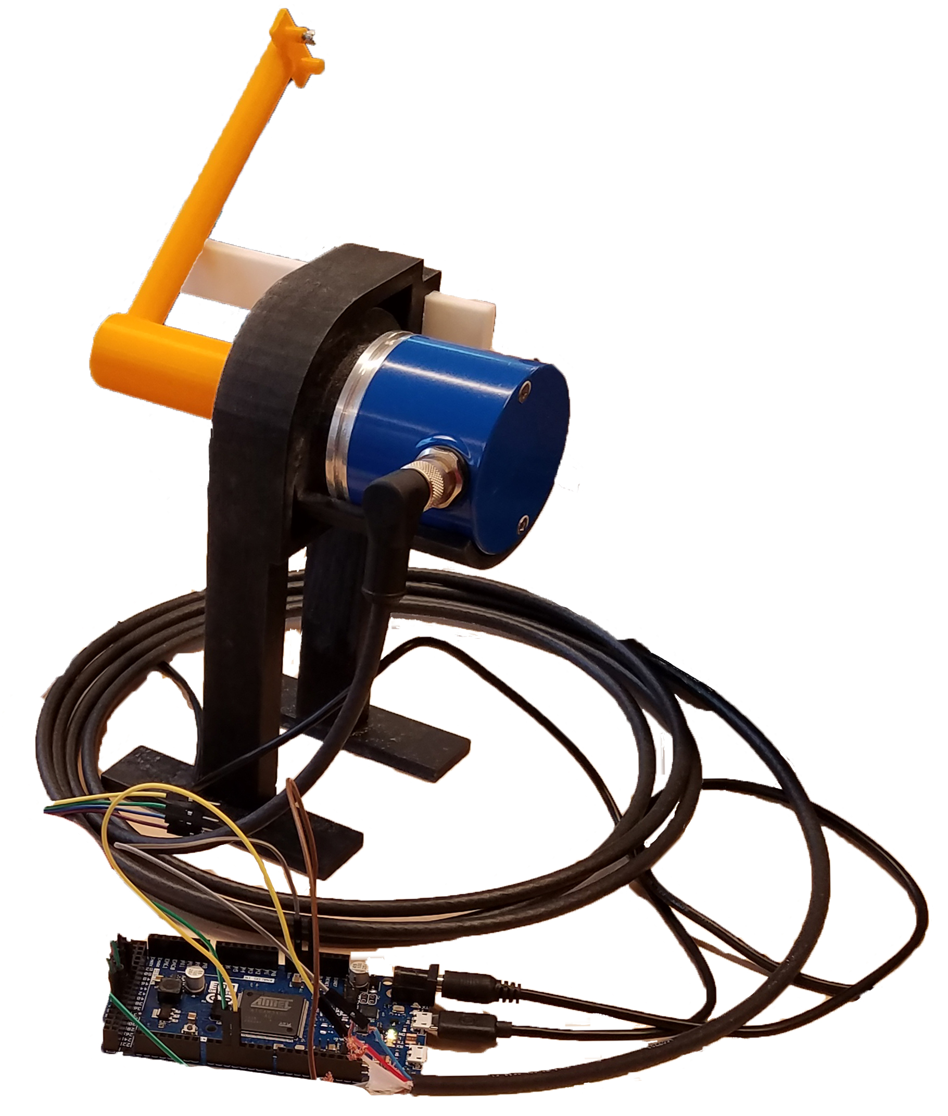
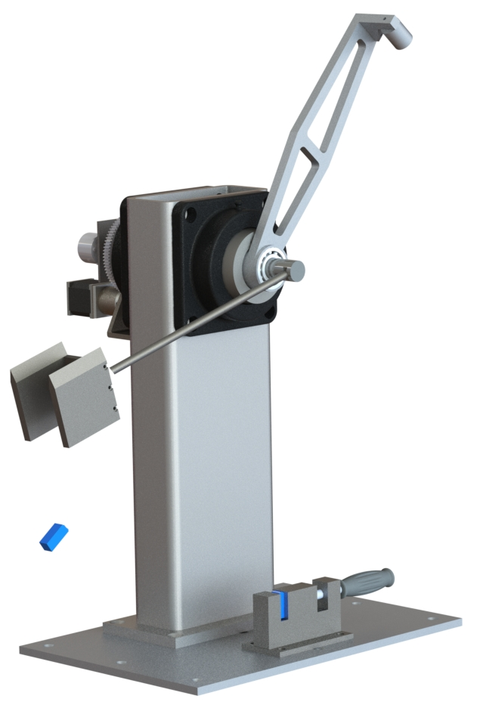
520
IZOD Impact Resistance Test Apparatus
Team members: Arnaud Debraine, Abdullah Almarri, Stephanie Fulenwider, Greg Nelson | Faculty adviser: Dr. Ibrahim Guven
Introduction
Pendulum style impact testing is used to measure a materials toughness
Toughness is a factor of a materials ability to absorb energy with out fracturing
Fracture toughness is one of the more important material properties for design applications
Design Process
Control System
Arduino Due Board: Microcontroller for apparatus control and data collection
Motor Control Board: Supplies power to operate Stepper Motor and Electromagnet
Raspberry Pi: Runs program and translates sensor output into useable data
Project Deliverables
Design and fabricate pendulum style impact testing apparatus
Sensor setup to measure the initial and final heights of the impactor head
Software component to interact with the sensor and capture data
Adherence to ASTM and OSHA guidelines and standards
Apparatus Operation
Initial start up will require operator to Calibrate starting position
Operator will select the Loading option. Moving the pendulum and allowing access to load next test specimen.
After specimen loading, operator selects the Run option.
Stepper Motor raises pendulum to the ASTM required height and the Arduino will record position measured by the encoder.
Electromagnet is de-energized allowing the pendulum to fall and impact the test specimen.
Specimen fractures and pendulum will swing to a final height.
Arduino captures final height from the encoder and pendulum acceleration through the fracture of the specimen.
Raspberry Pi will translate the data into Impact Energy and Fracture Toughness, displaying it on the screen and saving a text file of all the data.
Structural Analysis
ANSYS 2018 used to measure deflection in the structural members
G-Force simulated by applying a force normal to the bottom of the weighted side plates
Prototype
3D Printed a scaled down model to simulate the IZOD test apparatus motion
Incorporated the encoder, microcontroller and MEMS accelerometer
Allowed the team to validate the program architecture through testing
Design Team Input
Semi-Automated the system by adding a DC motor to control pendulum arm motion
Used an electromagnet to control the release of the pendulum arm. This will decouple the pendulum from the motor allowing for unrestricted motion and negating any potential energy loss.
Installed additional sensor to measure and record pendulum acceleration
Installed touch screen control system

